Slide 1
Windows Azure Storage
Blob Storage

Slide 2
What is Blob Storage
Windows Azure Blob storage is a service for storing large amounts of unstructured data that can be accessed from anywhere in the world via HTTP or HTTPS.
A single blob can be hundreds of gigabytes in size, and a single storage account can contain up to 100TB of blobs.

Slide 3
What is Blob Storage
Common uses of Blob storage include:
Serving images or documents directly to a browser
Storing files for distributed access
Streaming video and audio
Performing secure backup and disaster recovery
Storing data for analysis by an on-premises or Windows Azure-hosted service
You can use Blob storage to expose data publicly to the world or privately for internal application storage.

Slide 4
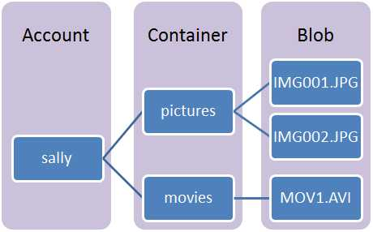
Blob Storage

Slide 5
Blob Storage
Storage Account: All access to Windows Azure Storage is done through a storage account.
This is the highest level of the namespace for accessing blobs.
An account can contain an unlimited number of containers, as long as their total size is under 100TB.

Slide 6
Blob Storage
Container: A container provides a grouping of a set of blobs.
All blobs must be in a container.
An account can contain an unlimited number of containers.
A container can store an unlimited number of blobs.

Slide 7
Blob Storage
Blob: A file of any type and size.
There are two types of blobs that can be stored in Windows Azure Storage: block and page blobs.
Most files are block blobs. A single block blob can be up to 200GB in size.
Page blobs, can be up to 1 TB in size, and are more efficient when ranges of bytes in a file are modified frequently.

Slide 8
Blob Storage
URL format: Blobs are addressable using the following URL format:
http://<storage account>.blob.core.windows.net/<container>/<blob>
http://sally.blob.core.windows.net/movies/MOV1.AVI

Slide 9
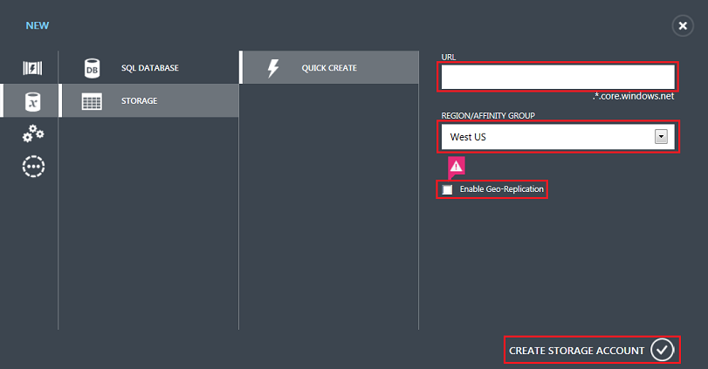
Create Storage Account

Slide 10
Setup a storage connection string
The Windows Azure Storage Client Library for .NET supports using a storage connection string to configure endpoints and credentials for accessing storage services.
You can put your storage connection string in a configuration file, rather than hard-coding it in code.
When using Windows Azure Cloud Services, it is recommended you store your connection string using the Windows Azure service configuration system (*.csdef and *.cscfg files).

Slide 11
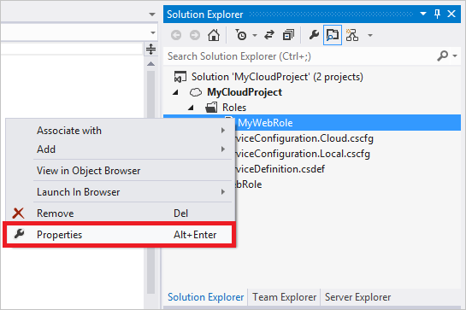
Setup a storage connection string

Slide 12
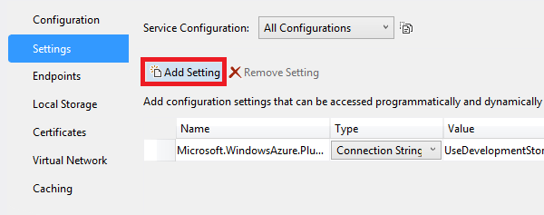
Setup a storage connection string

Slide 13
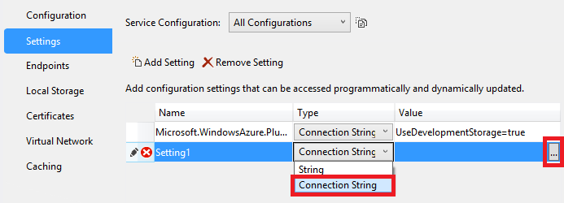
Setup a storage connection string

Slide 14
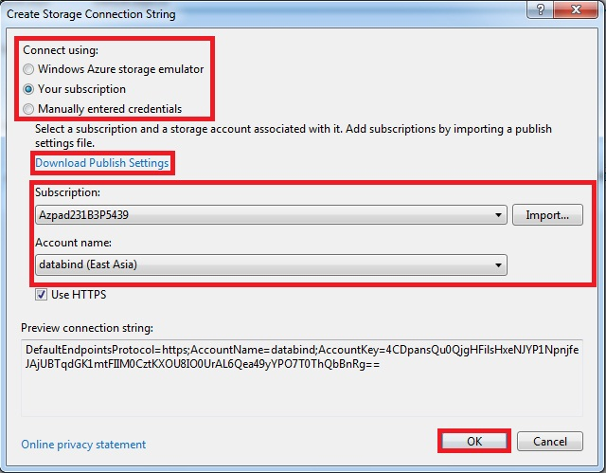
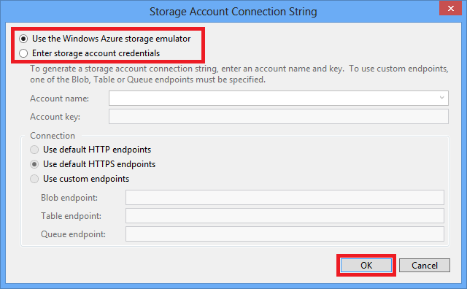
Setup a storage connection string

Slide 15
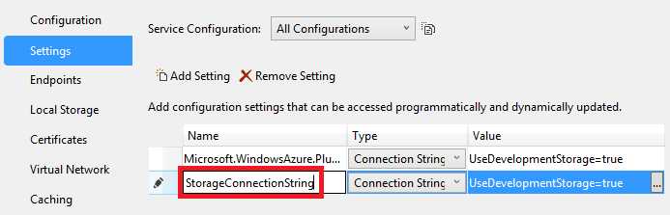
Setup a storage connection string

Slide 16
Access blob storage
Add the following namespace declarations to the top of any C# file in which you wish to programmatically access Windows Azure Storage:
using Microsoft.WindowsAzure;
using Microsoft.WindowsAzure.Storage;
using Microsoft.WindowsAzure.Storage.Auth;
using Microsoft.WindowsAzure.Storage.Blob;
Microsoft.WindowsAzure.Storage.dll assembly is to be added.

Slide 17
Access blob storage
Retrieving your connection string
use the CloudConfigurationManager type to retrieve your storage connection string and storage account information from the Windows Azure service configuration:
CloudStorageAccount storageAccount = CloudStorageAccount.Parse( CloudConfigurationManager.GetSetting("StorageConnectionString"));

Slide 18
Access blob storage
A CloudBlobClient type allows you to retrieve objects that represent containers and blobs stored within the Blob Storage Service.
The following code creates a CloudBlobClient object using the storage account object we retrieved above:
CloudBlobClient blobClient = storageAccount.CreateCloudBlobClient();

Slide 19
Access blob storage
Create a container
use a CloudBlobClient object to get a reference to the container you want to use. You can create the container if it doesn't exist:

Slide 20
Access blob storage
Create a container...
// Retrieve a reference to a container.
CloudBlobContainer container = blobClient.GetContainerReference("mycontainer");
// Create the container if it doesn‘t alreadyexist.
container.CreateIfNotExists();

Slide 21
Access blob storage
Create a container...
By default, the new container is private and you must specify your storage access key to download blobs from this container.
If you want to make the files within the container available to everyone, you can set the container to be public using the following code:

Slide 22
Access blob storage
Create a container...
Container.SetPermissions(new BlobContainerPermissions{ PublicAccess= BlobContainerPublicAccessType.Blob });

Slide 23
Access blob storage
To upload a file to a block blob, get a container reference and use it to get a block blob reference.
Once you have a blob reference, you can upload any stream of data to it by calling the UploadFromStream method.
This operation will create the blob if it didn't previously exist, or overwrite it if it does exist.

Slide 24
Access blob storage
To upload a file
// Retrieve reference to a blob named "myblob".
CloudBlockBlob blockBlob = container.GetBlockBlobReference("myblob");

Slide 25
Access blob storage
To upload a file
// Create or overwrite the "myblob"
//with contents from a local file.
using (var fileStream = System.IO.File.OpenRead(@"path\myfile")) { blockBlob.UploadFromStream(fileStream); }

Slide 26
Access blob storage
To download a file from a block blob, get a container reference and use it to get a block blob reference.
Once you have a blob reference, you can download any stream of data from it to any file by calling the DownloadToStream method.

Slide 27
Access blob storage
To Download a file
// Retrieve reference to a blob named "myblob".
CloudBlockBlob blockBlob = container.GetBlockBlobReference("myblob");

Slide 28
Access blob storage
To download a file
// Create or overwrite the file
//with contents from a "myblob".
using (var fileStream = System.IO.File.OpenWrite(@"path\myfile")) { blockBlob.DownloadToStream(fileStream); }

Slide 29
Access blob storage
To delete a block blob, get a container reference and use it to get a block blob reference.
Once you have a blob reference, you can delete any blob by calling the Delete method.

Slide 30
Access blob storage
To Delete a file
// Retrieve reference to a blob named "myblob".
CloudBlockBlob blockBlob = container.GetBlockBlobReference("myblob");
//Delete BlockBlob
blockBlob.Delete();

